Slide 1

Building a Calculator App with Tkinter
In this tutorial, we'll walk through the step-by-step process of creating a simple yet powerful calculator application using the Tkinter library in Python. By the end, you'll have a functional and visually appealing calculator that can perform basic arithmetic operations.

Slide 2

Importing the necessary modules
1
Tkinter
2
Messagebox
The primary GUI toolkit for Python, allowing us to create the calculator's user interface.
Used to display error messages and provide feedback to the user.
3
OS
Allows us to interact with the operating system, such as creating and managing files.

Slide 3

Defining the history function
Storing Calculations
Persistent Data
Debugging Aid
The history function writes each calculation to a text file, keeping a record of the user's activity.
This allows the user to review their past calculations even after closing and reopening the app.
The history file can also be useful for troubleshooting and understanding user behavior.

Slide 4
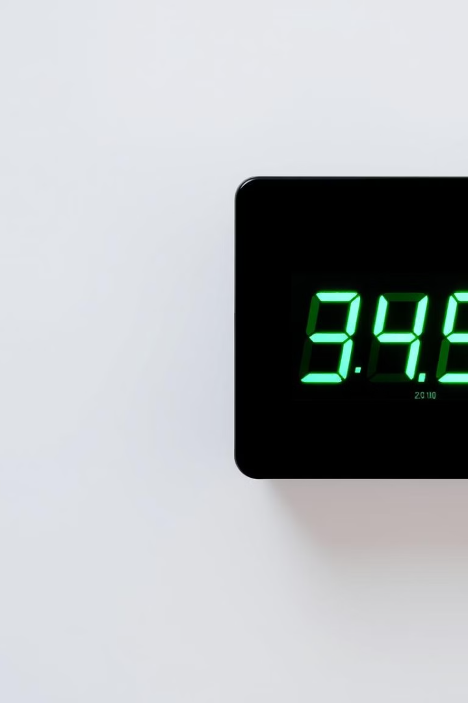
Implementing the timer function
1
Start Timer
When a calculation is performed, the timer function is called to display a "Calculating..." message.
2
Delay
The timer waits for 1 second before clearing the "Calculating..." message, providing visual feedback to the user.
3
Instant Feedback
This timer function enhances the user experience by indicating that the app is processing the calculation.

Slide 5
Defining the calculate function
Input Validation
Arithmetic Operations
Error Handling
The calculate function first checks that the user has entered valid numbers in the input fields.
Depending on the selected operation, the function performs the necessary calculation and stores the result.
Any errors, such as division by zero, are caught and displayed to the user using the messagebox module.

Slide 6
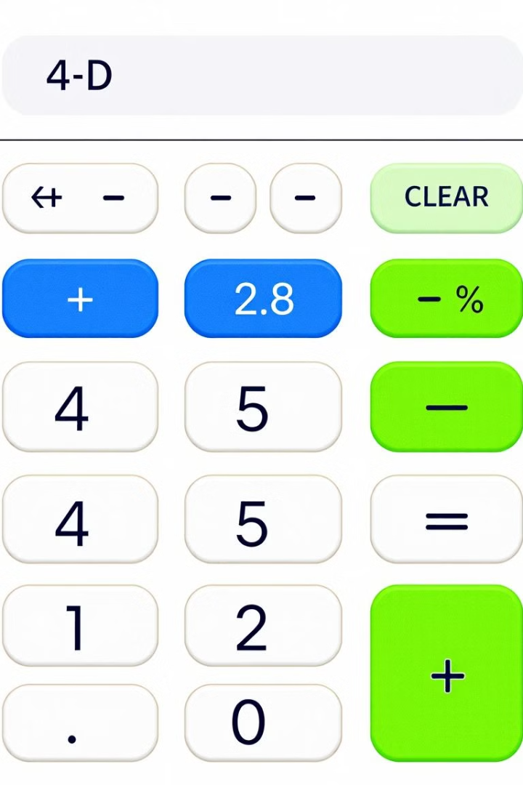




Handling different operations
Addition
Subtraction
Adds the two input numbers together.
Subtracts the second number from the first.
Multiplication
Division
Multiplies the two input numbers.
Divides the first number by the second.

Slide 7




Displaying the result and updating the history
Display Result
Update History
Persistent Records
The calculated result is shown in the output field of the calculator.
The history function is called to log the calculation in the text file.
Users can review their past calculations by opening the history.txt file.

Slide 8

Conclusion and next steps
In this tutorial, you've learned how to build a basic calculator app using Tkinter in Python. To further enhance the application, you could explore adding more features, such as scientific operations, a clear button, or the ability to save and load calculation histories.

